Slide 1
Institute Management Portal
Group Members :
Kishori Attarde (220343120048)
Aditya Deshpande (220343120032)
Aishwarya Shinde (220343120101)
Swapnil Pachupate (220343120106)
Project Guide :
Mrs. Harshita Maheshwari

Slide 2
Contents
Introduction
Choice of Topic
Proposed System
Methodology
Proposed System Model
Proposed Approach
Screenshots
System Requirements
Applications
Advantages & Limitations
Conclusion
Future Scope
References

Slide 3
Introduction
Institute Management Portal is a web application for students as well as faculties.
Via this application, We can onboard new students and faculties in the institute.
They can view and update the details.
Faculty can upload assignments and study material via this portal.
Students can access the faculty uploaded assignments as a task to do and also download the study material in their system. Student can upload completed assignments via this portal as well.
Faculty and Students both can view the weekly schedules for the respective courses from this portal.

Slide 4
Choice of topic
Student and faculty can have all time access of the functionalities via designated portal.
More helpful for Student Point of View.
Easy to understand and fast.

Slide 5
Proposed System
Much helpful for students who take admission into respective Institute.
Proposed System:
Strong Database to store Admin, Student, Faculty records.
One designated platform to access study materials helpful for students.
Students can find their course details via this module.
Students and faculty can easily find their timetable schedule just by filtering data or otherwise.

Slide 6
Methodology
The Objective is to create a website that can perform the following :
Connecting to an HTTPS site through Internet.
Opening the relevant pages using HTTPS POST & GET Methods.
Read the data into Admin, Student, Faculty.
Creating a local database.

Slide 7
Proposed System Model
There are three main modules:
Admin Student Faculty
1.Study Material 1. Study Material 1. Study Material
2. Course 2. Time Table 2. Time Table
3. TimeTable 3. Course 3. Faculty Profile
4. Admin Profile 4. Student Profile 4. LogOut
5. LogOut 5. LogOut

Slide 8
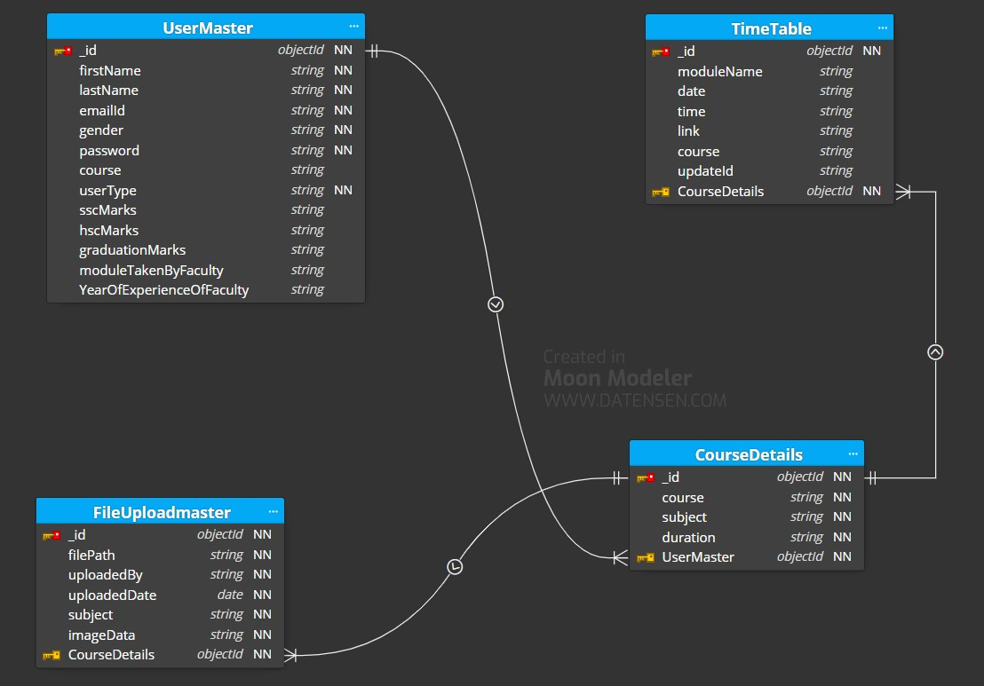
Proposed Approach

Slide 9
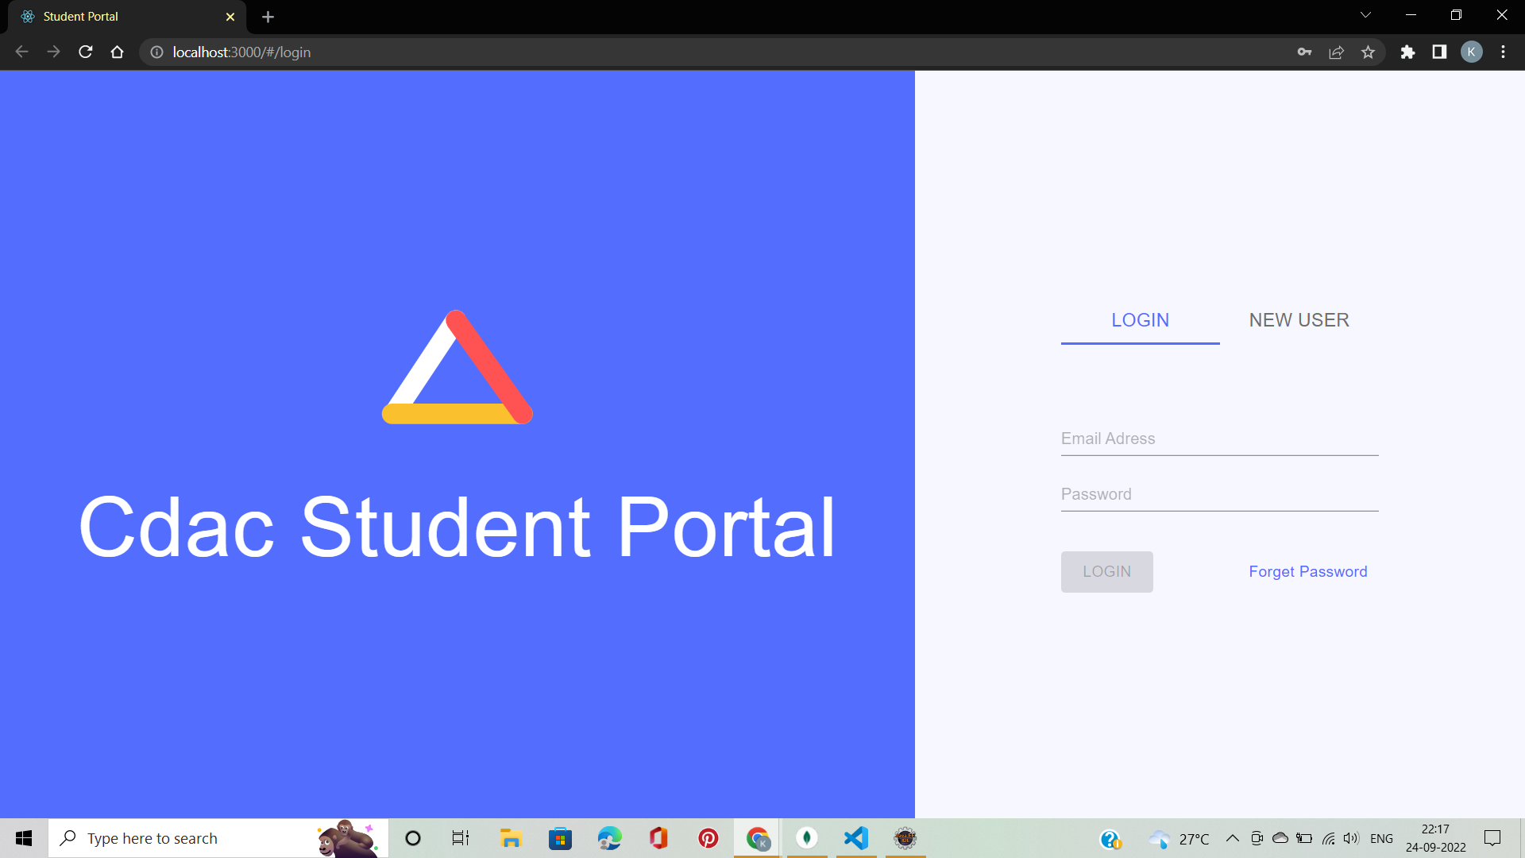
Screenshots

Slide 10
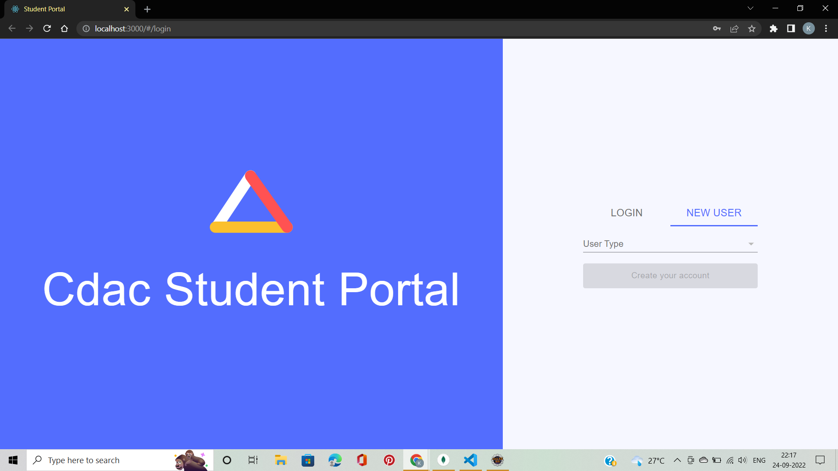
Screenshots

Slide 11
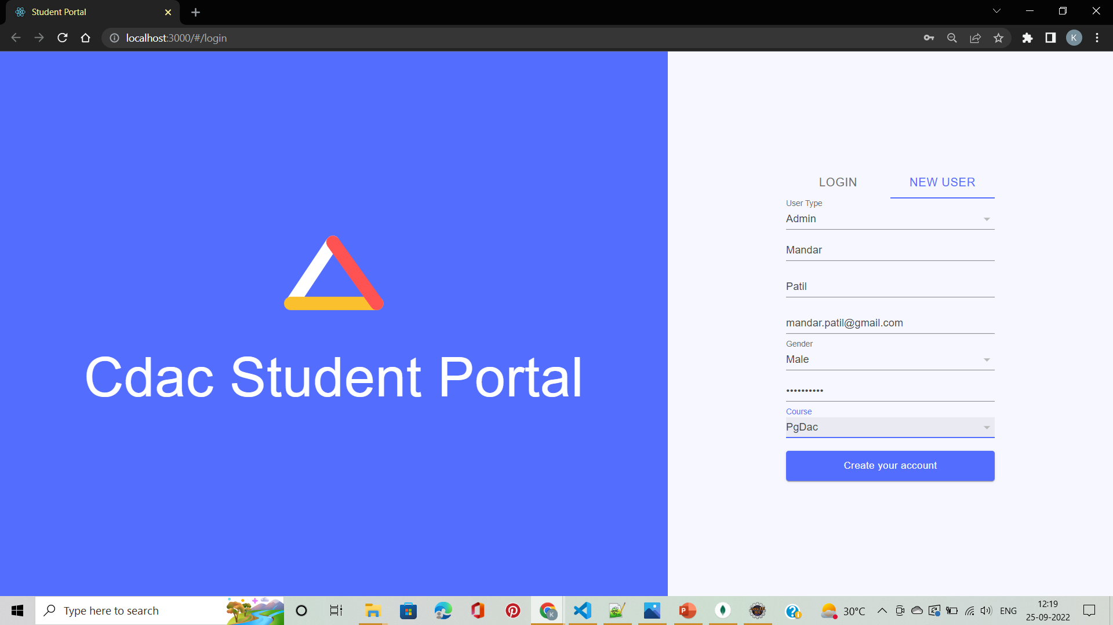
Screenshots

Slide 12
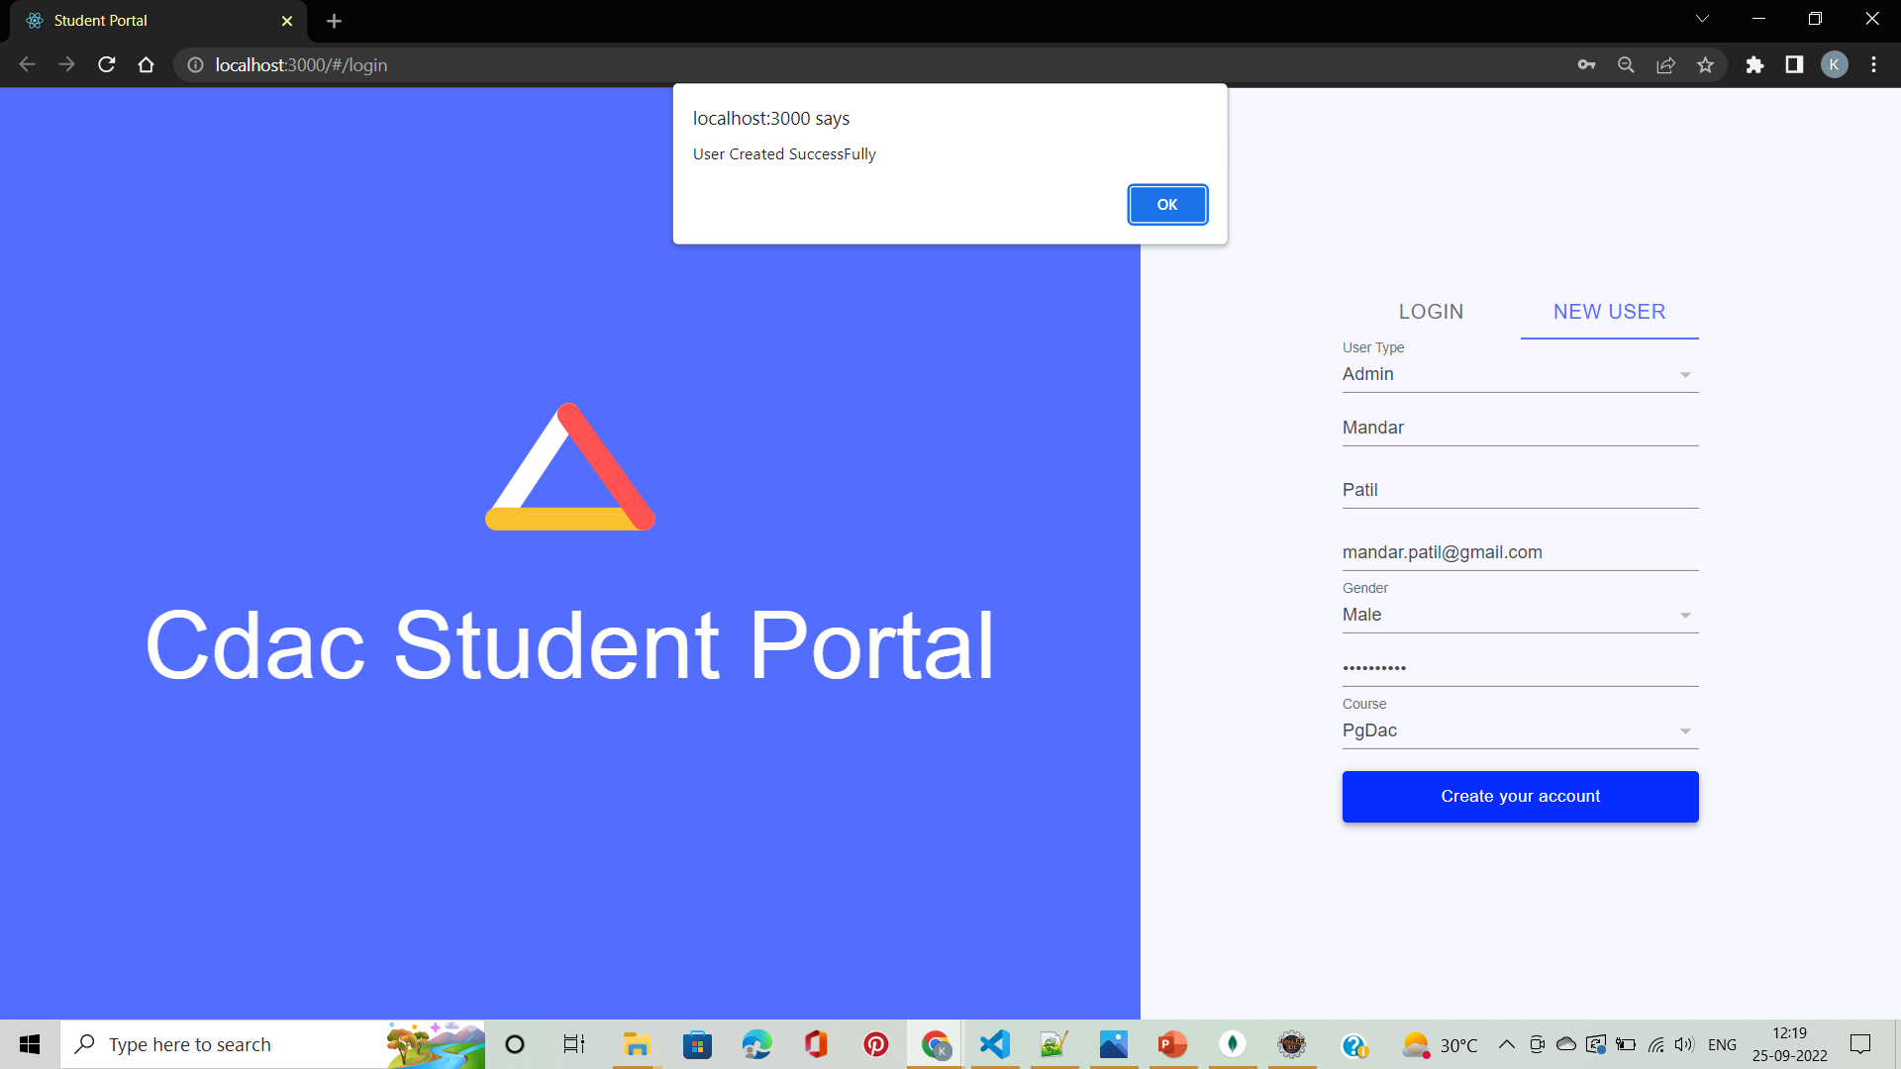
Screenshots

Slide 13
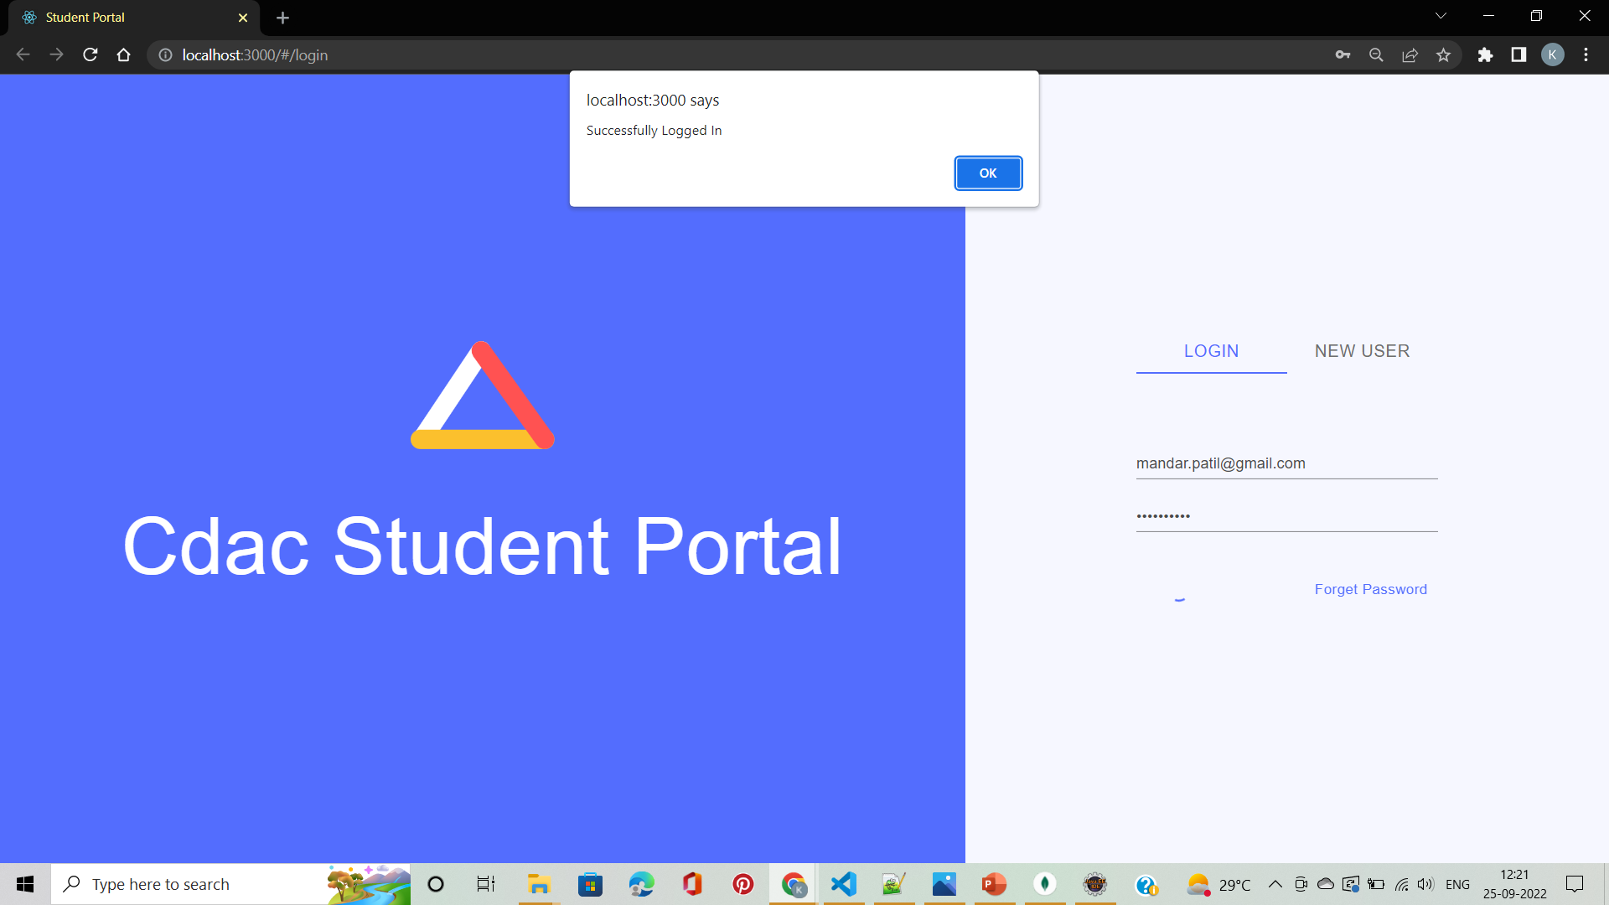
Screenshots

Slide 14
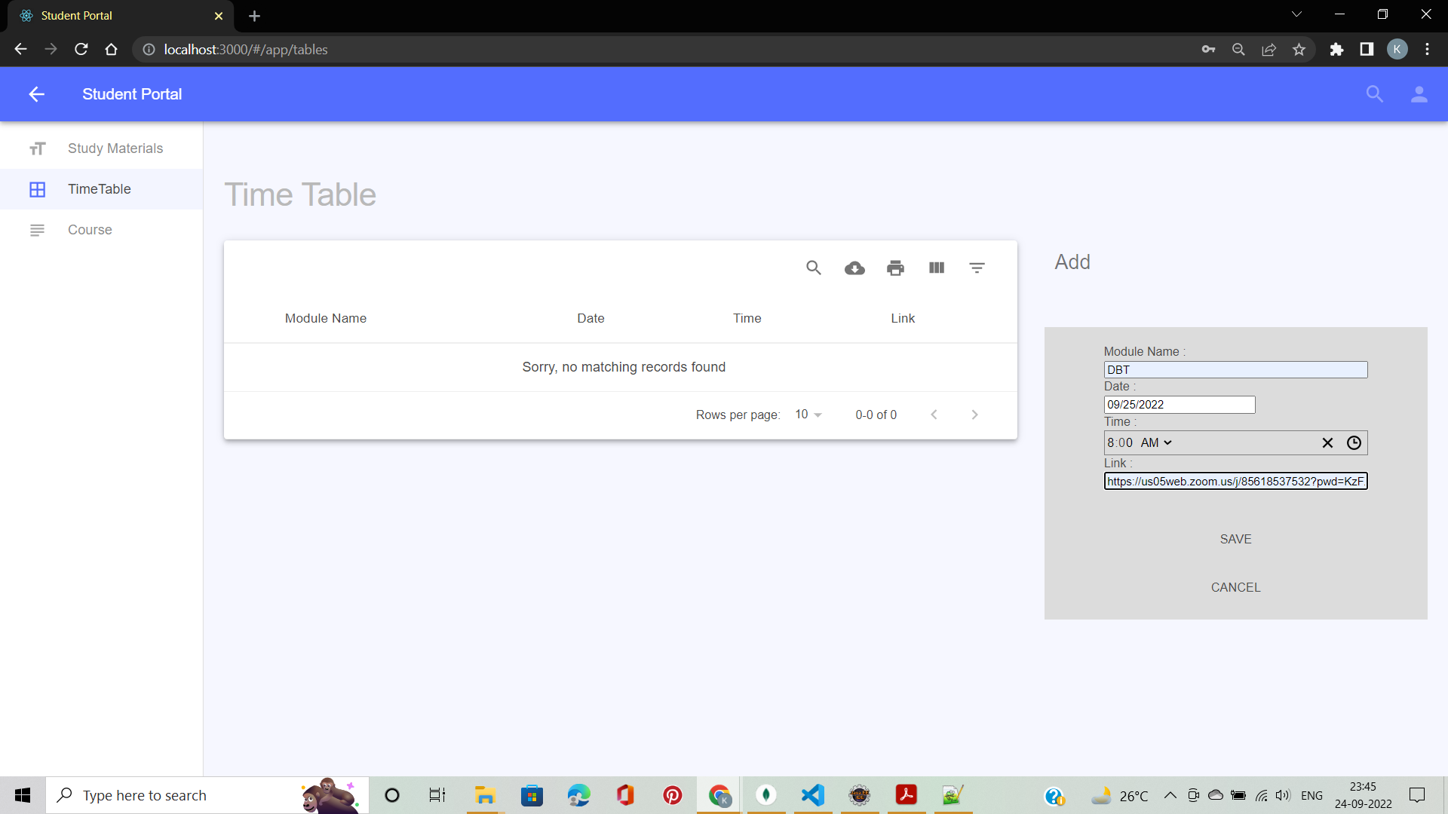
Screenshots

Slide 15
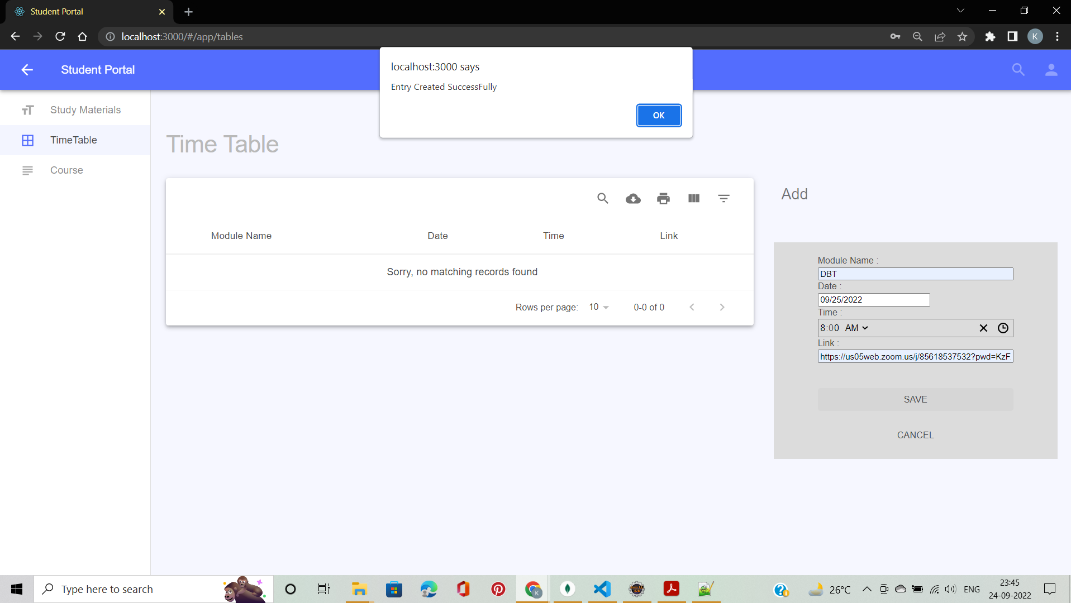
Screenshots

Slide 16
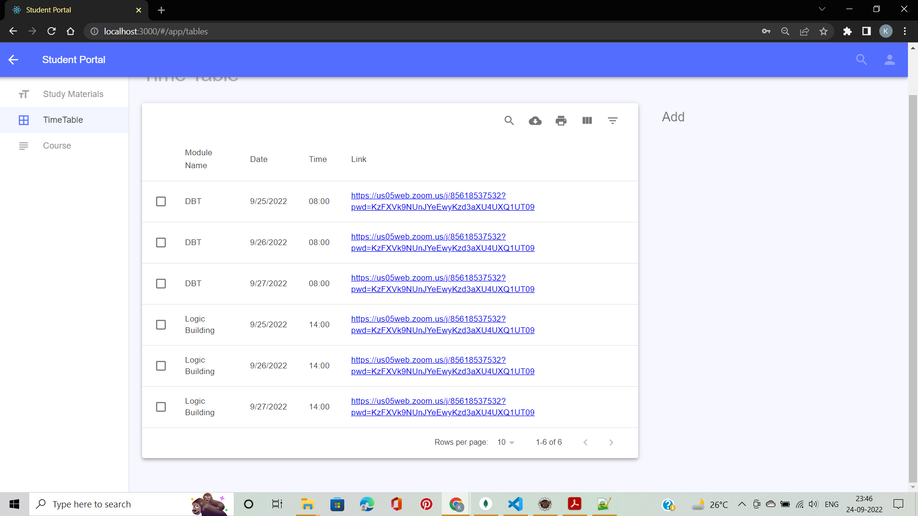
Screenshots

Slide 17
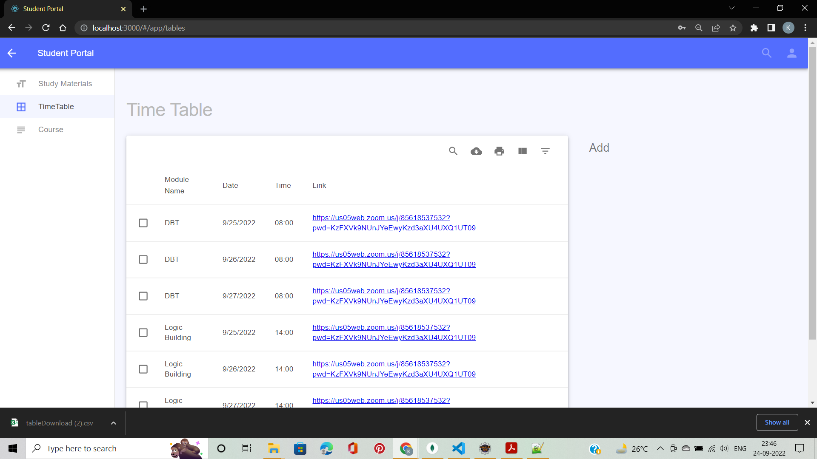
Screenshots

Slide 18
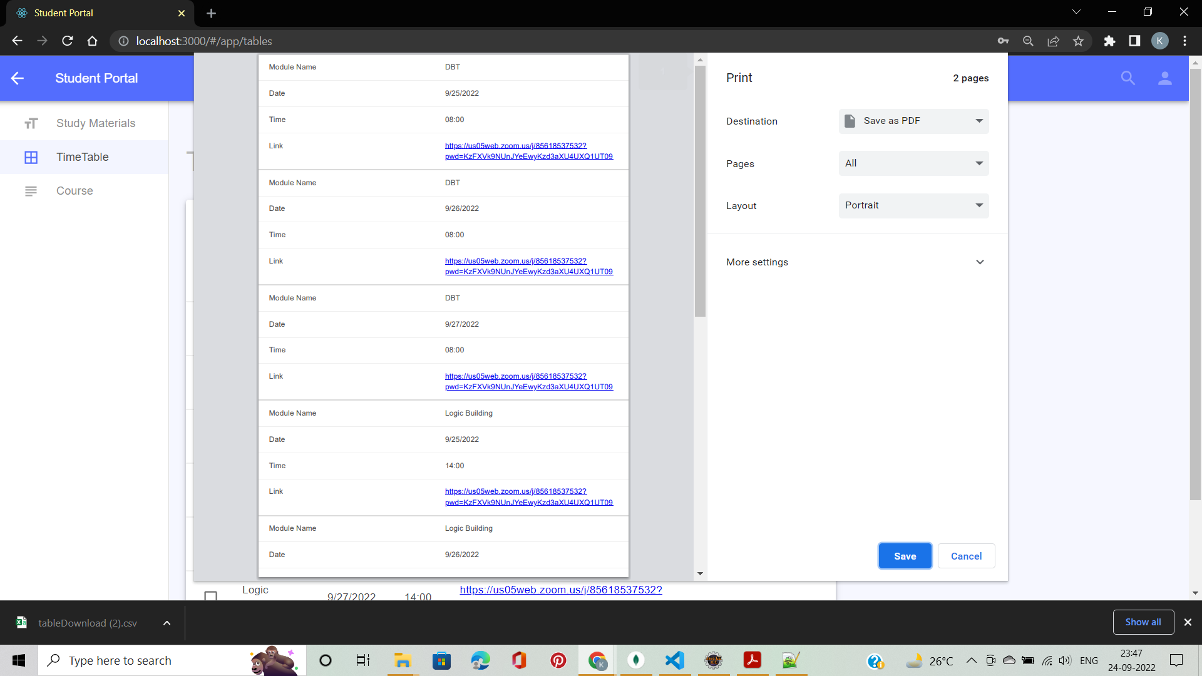
Screenshots

Slide 19
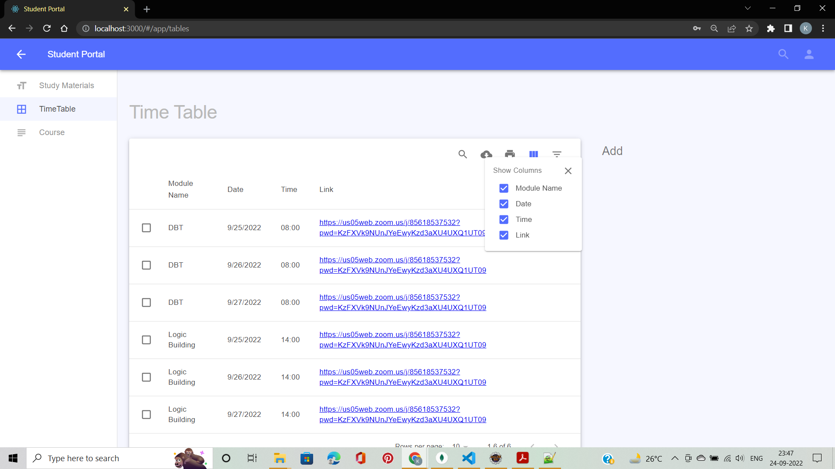
Screenshots

Slide 20
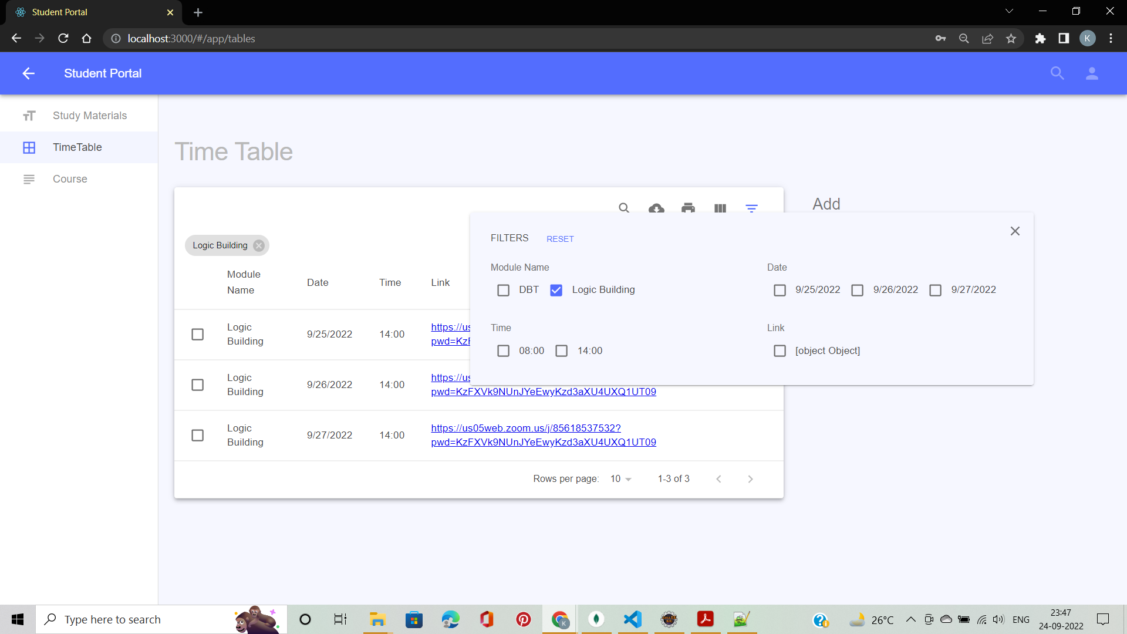
Screenshots

Slide 21
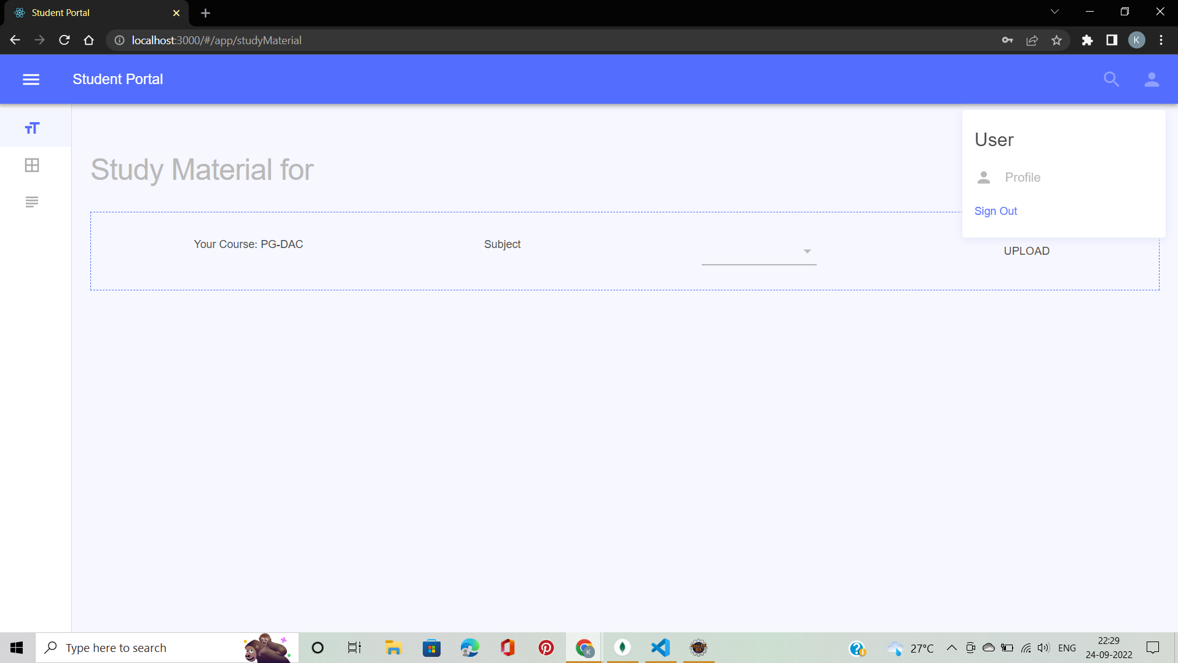
Screenshots

Slide 22
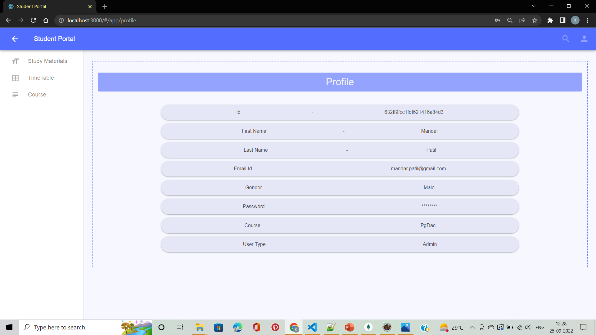
Screenshots

Slide 23

Screenshots

Slide 24
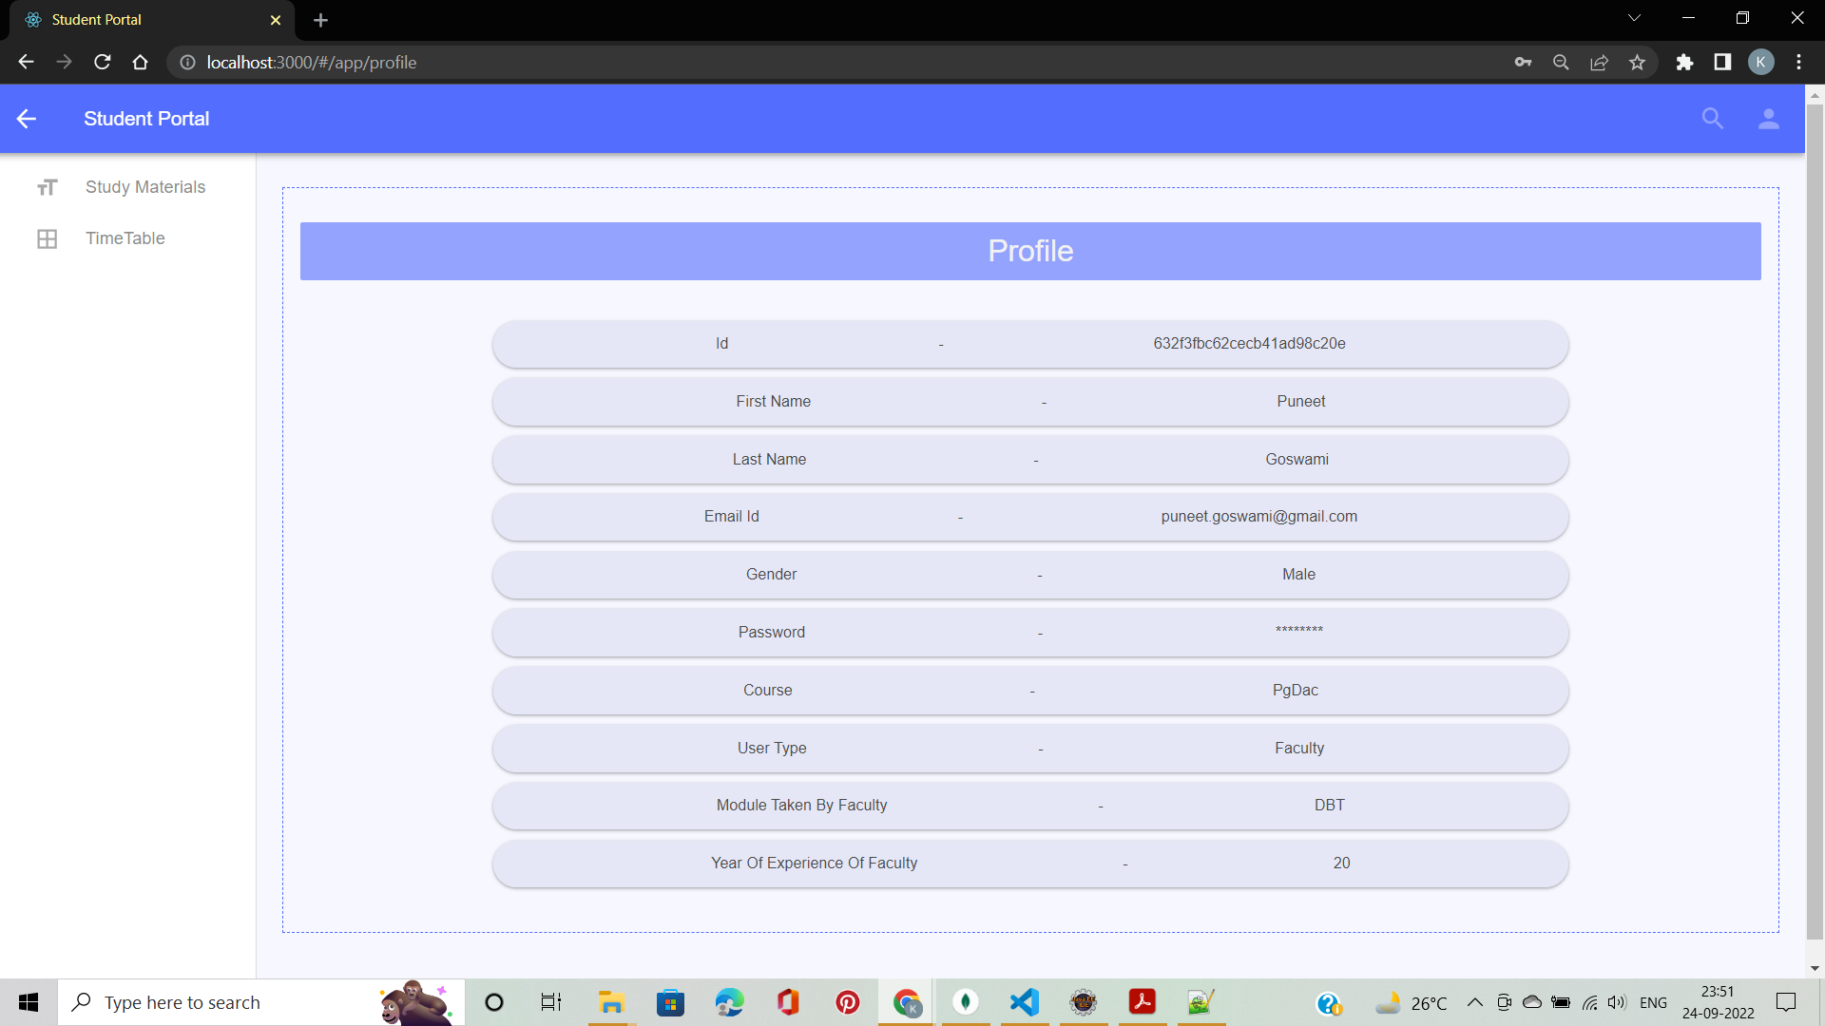
Screenshots

Slide 25

Screenshots

Slide 26
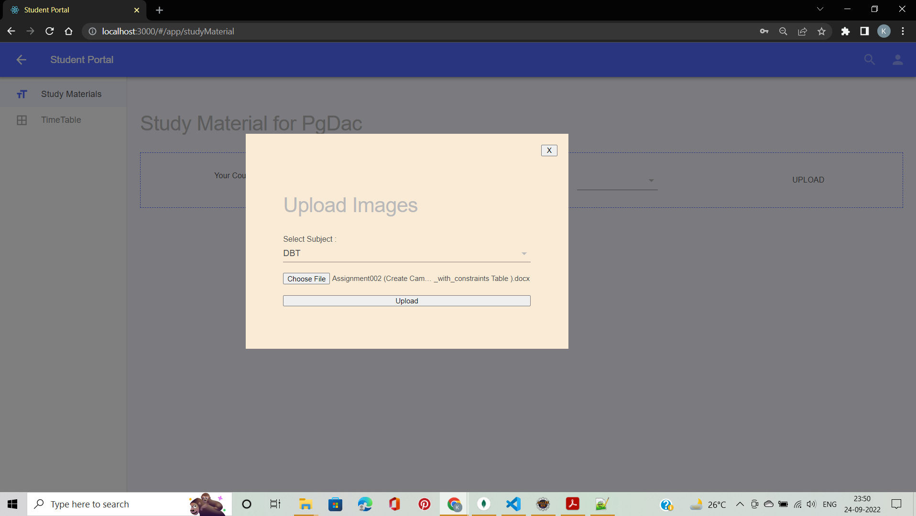
Screenshots

Slide 27
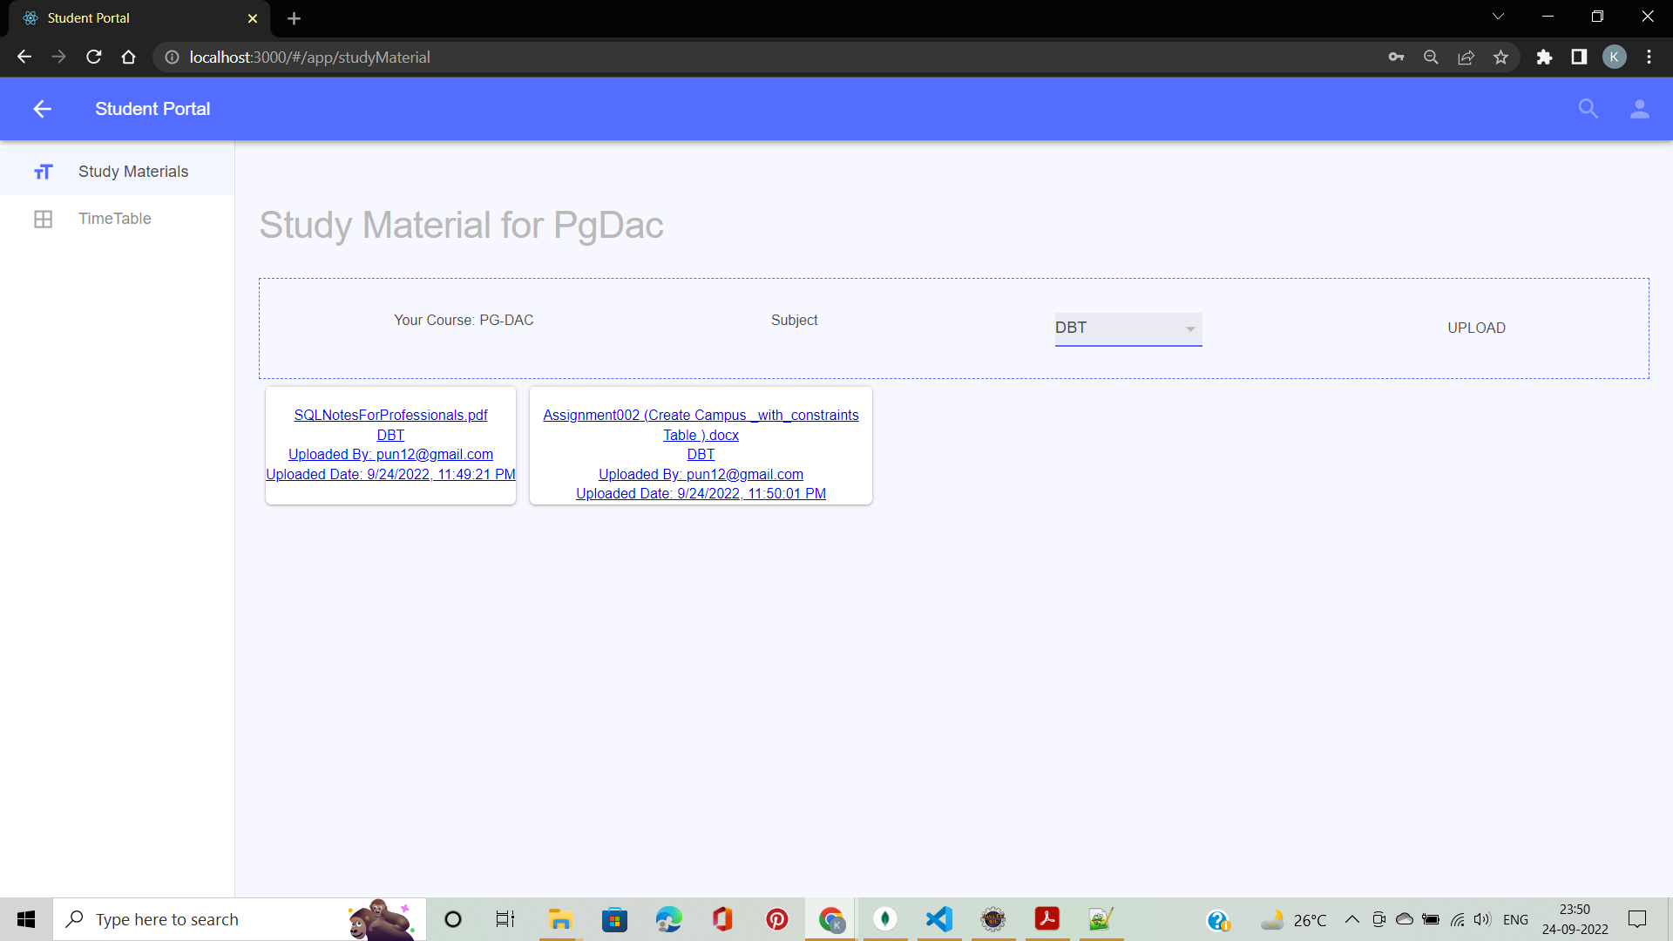
Screenshots

Slide 28

Screenshots

Slide 29

Screenshots

Slide 30

Screenshots

Slide 31
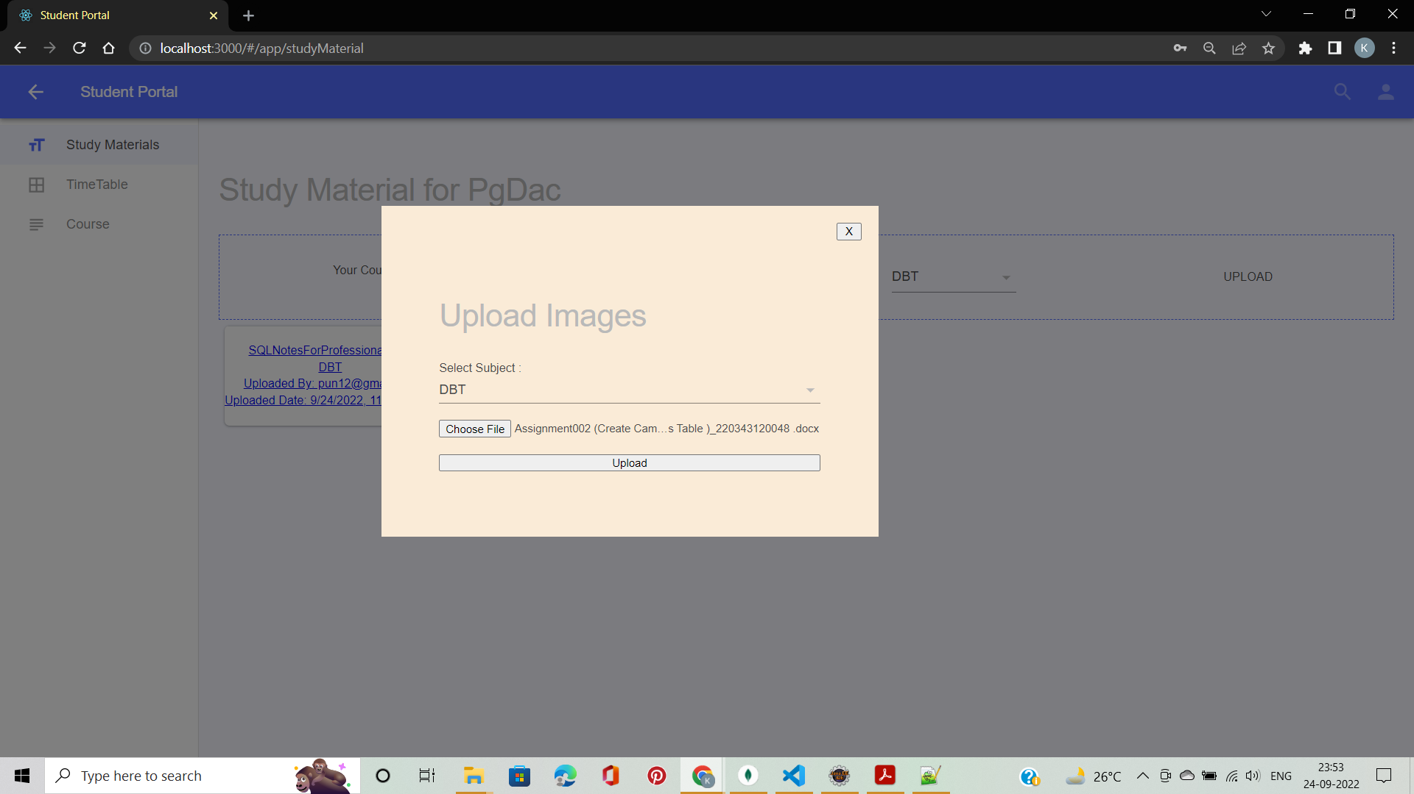
Screenshots

Slide 32
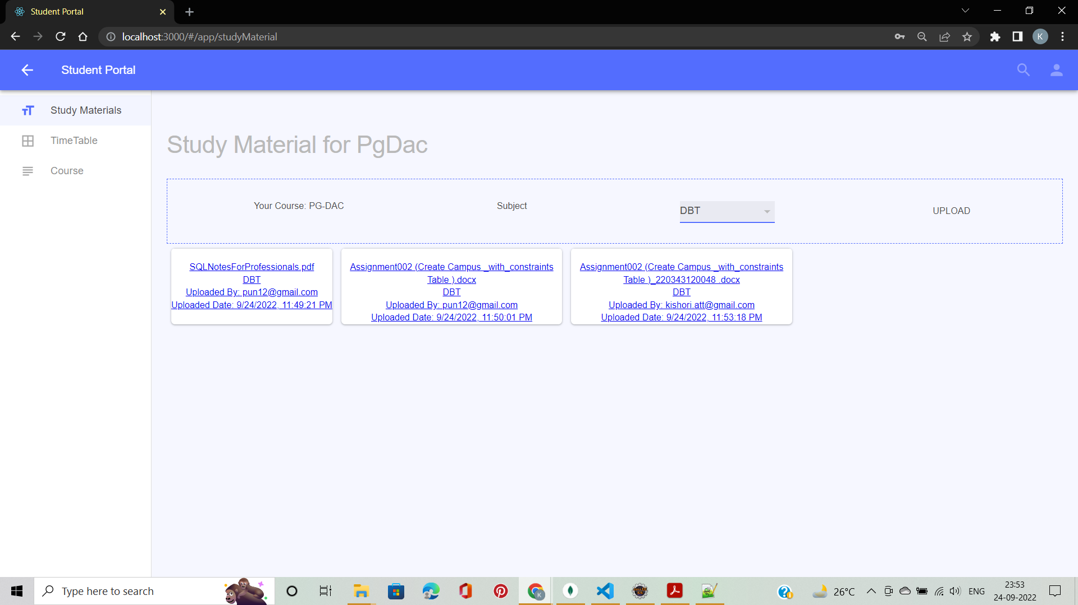
Screenshots

Slide 33
System Requirements
Software Requirements:
Windows (All versions)
Google Chrome Browser (Preferred)
Eclipse
MongoDB
VSCode
Postman
Git

Slide 34
System Requirements
Hardware Requirements:
Processor : Intel Core i3 or above
Memory : 8GB RAM or above
Hard disk : 5GB
Network : Ethernet / WiFi

Slide 35
Technologies Used
ReactJS : Page Layout, Styling of the page, validations and UI developed by using React JS.
Java Spring boot : All the business logic has been written in Java using Spring boot Framework.
MongoDB : Non-Relational MongoDB Schema is used for database.
Tomcat : Project run using Tomcat Server 8.5

Slide 36
Applications
Digitization of Records.
Can be modified according to different Institutes.
Education Industry.

Slide 37
Advantages
Personalized portal for respective Institutes.
Easy access to study material and assignments at one place.
Can view schedules just by one login into the institute.
Student and Faculty can easily access timetable schedule without going through n number of mails as in traditional ways.

Slide 38
Limitations
It requires extensive database and memory.
User verification in online mode is not much secure.

Slide 39
Conclusion
Institute Management Portal can be used by educational institutions to maintain their student and faculty records easily. Achieving this objective is difficult using the traditional system as the information is scattered, can be redundant, and collective relevant information maybe very time consuming. Also sharing timetable schedules, study materials like notes, ppt, assignments via email is a hassle as mailbox are filled with n number of different kinds of mail which makes our important mails go down and need to be searched everytime. Using this portal just with one click or any filter we can easily access our weekly schedule as well as study material. All these problems are solved by this project.

Slide 40
Future Scope
Improvement in design.
Mobile Application
Course Fees Payment
Discussion Forum
Chatting System

Slide 41
References
Mr. Saleel Bagde for Database
Mrs. Harshita Maheshwari for ReactJS
Mrs. Mayuri Fakirpure for Java Springboot
https://skill-lync.com/blogs/7-best-java-project-ideas-to-showcase-your-programming-skills
https://www.slideshare.net
https://projectideas.co.in/computer-and-it-engineering-projects/
https://wordpress.org/plugins/institute-management/

Slide 42
THANK YOU!!

